Slide 1
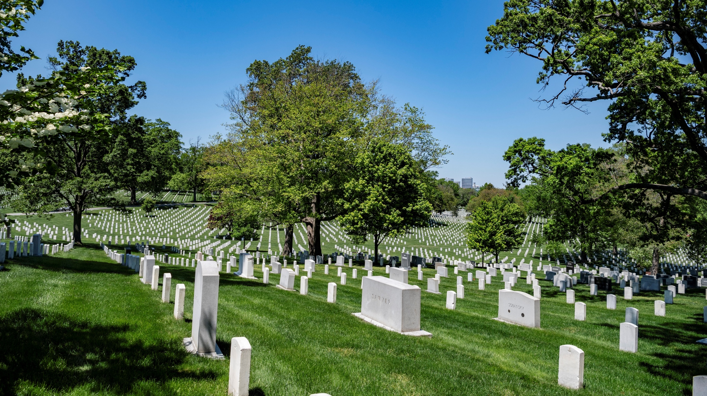
Welcome to Arlington National Cemetery!
Notes:
Slide Notes:
This slide is an introductory slide to welcome everyone to the virtual field trip and maybe ask a few questions to begin the experience.
Say & [Do]:
Welcome everyone! [Introduce yourself and any co-hosts].
On the screen, you can see an image of where we are headed today – Arlington National Cemetery!
Has anyone ever visited Arlington before? [Instruct learners that they can use the reaction buttons or give a thumbs up]
Does anyone want to share something they saw at Arlington?
[Move to next slide]
Photo Credit: https://www.flickr.com/photos/arlingtonnatl/49883321973/

Slide 2

Our Guiding Questions
What is Arlington National Cemetery?
Why does the cemetery exist?
Who is buried here?
To keep in mind:
Why does the cemetery matter?
Who do we honor and remember?
Notes:
Slide Notes:
This slide presents learners with the guiding questions for the field trip – specific points for them to focus on as they learn
Say & [Do]:
As we work today, we have a couple of guiding questions that we are going to try to answer. So, by the time that you leave here today, you should be able to answer the following questions:
What is Arlington National Cemetery?
Why does the cemetery exist?
And Who is buried here?
As we explore these questions together, I want you to keep in mind these reflection questions as well – why does the cemetery matter? Why are we doing this virtual field trip? And WHO do we honor and remember? These two words are really important to the people at Arlington, and to our exploration today, so we’ll talk through some of the ways we honor and remember the people buried here throughout our time.
To start answering some of these questions, let’s start by looking at some photos of Arlington National Cemetery. [Move to next slide]

Slide 3
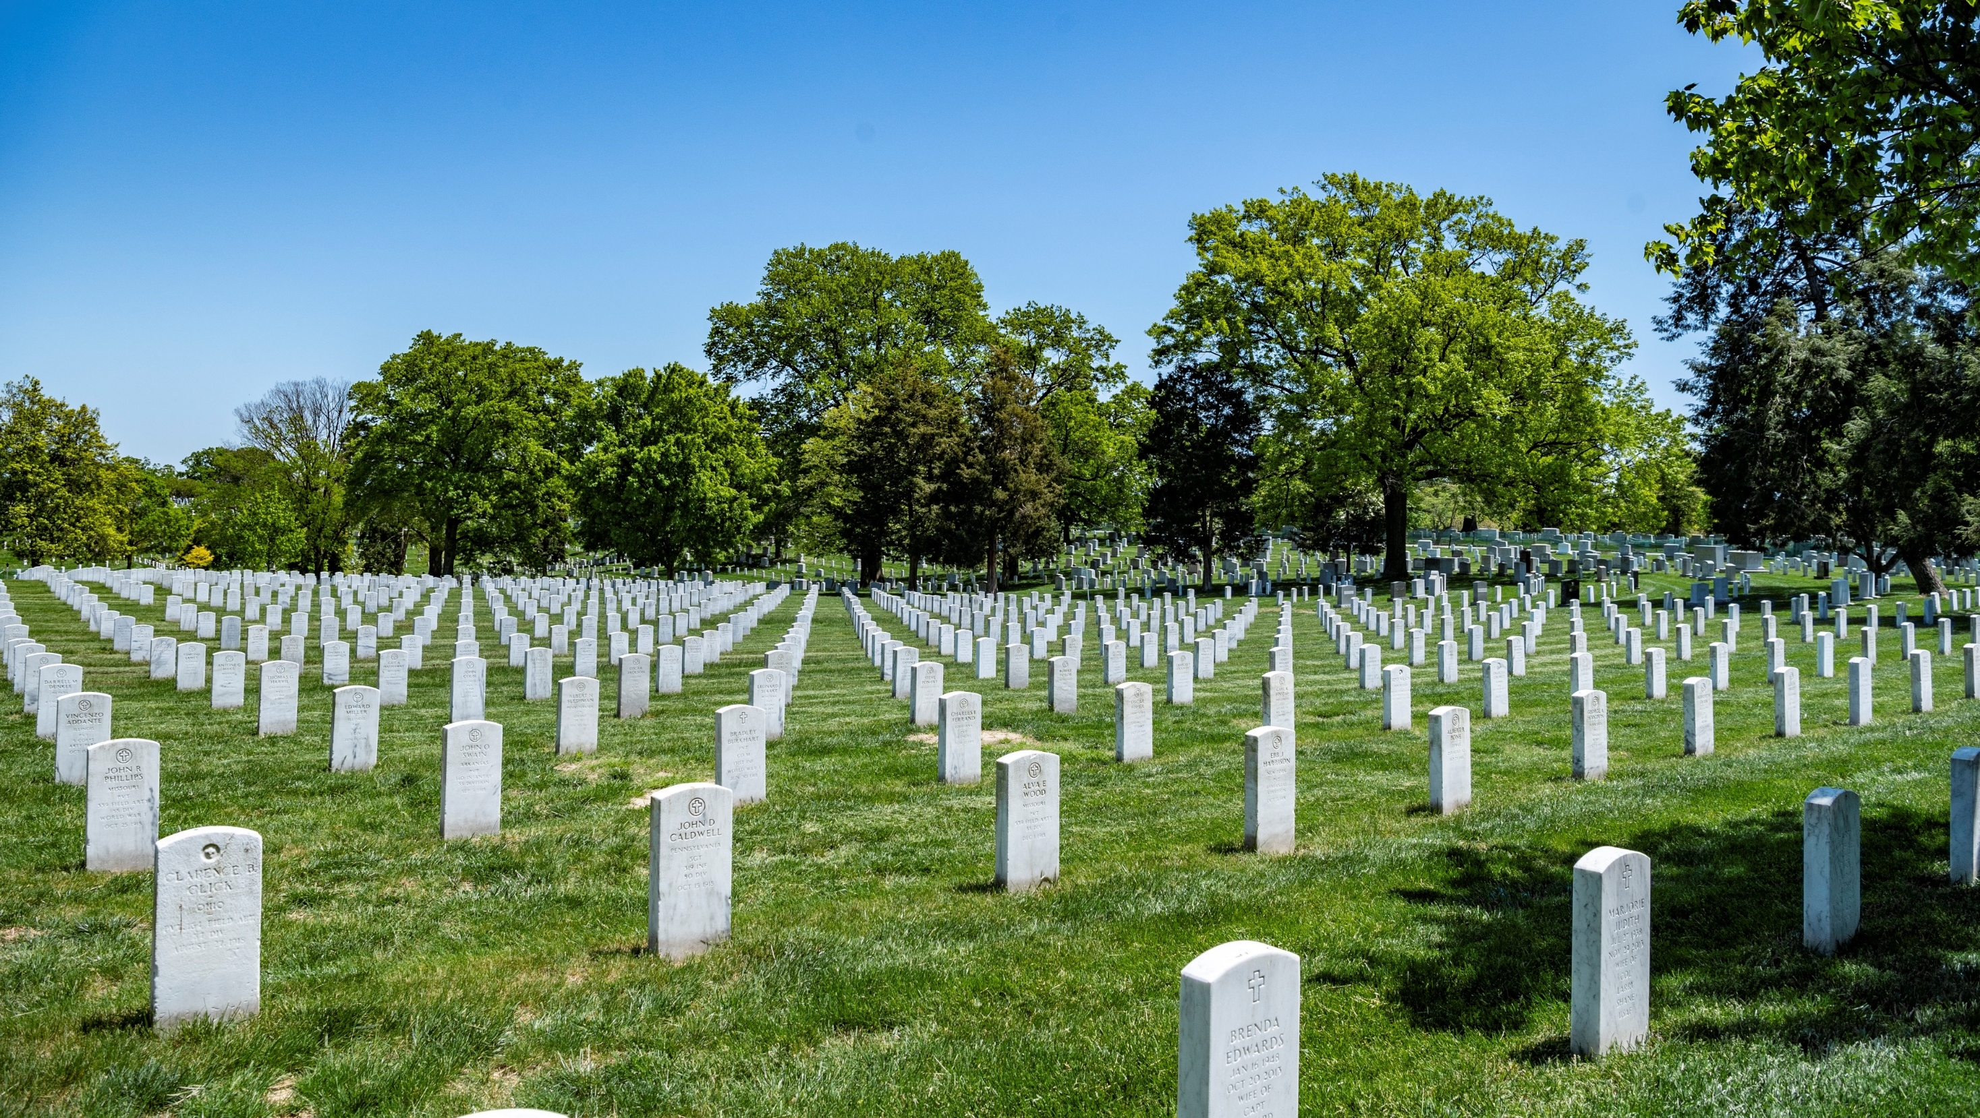
Notes:
Slide Notes:
This slide allows learners to share their observations of what they see when they examine this photograph of the cemetery.
Say & [Do]:
Here’s our first photograph. We have left our classroom and are now on the grounds of the beautiful Arlington National Cemetery. I want you to take a moment and just look at this picture. What do you see in this photograph? What sticks out to you as you observe this photo? [Give students a moment to look at the photograph and then respond to the questions. Acknowledge responses as they come in.]
Some things that you guys may be seeing:
Symbols: There are religious symbols here. Over time, the symbols have changed, and sometimes the symbols are different because of when the person was buried.
Headstones: There are lots of identical ones, in nice and neat rows, and different styles way in the back – might be a little hard to see right now, but we will revisit that later. These headstones are given to military service members by the government as a way to honor and remember their service to the country. In addition, there are family members of service members buried here as well.
Trees: There are lots of trees and beautiful lawns at Arlington and we have a whole horticulture team that works to keep the cemetery beautiful in order to help honor and remember the people buried there
In addition to being an active cemetery (people are still buried here every weekday), it is also an arboretum
Let’s try to take a closer look to see if we can determine who these headstones are remembering [Move to the next slide]
Photo Credit: https://www.flickr.com/photos/arlingtonnatl/49883319783/

Slide 4
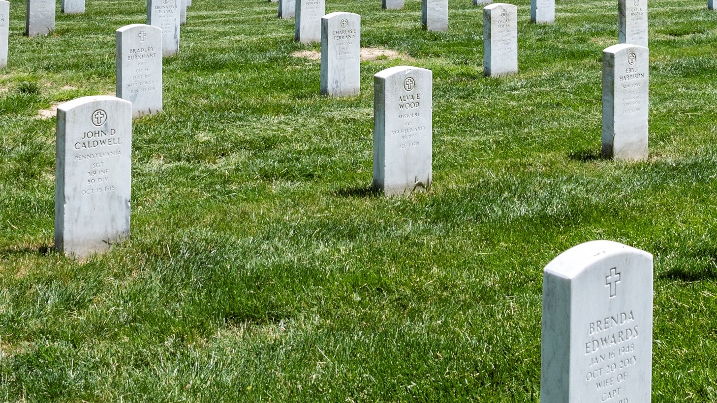
Notes:
Slide Notes:
This slide takes the same image from the previous slide and zooms in for a closer look at more details on the headstones themselves.
Say & [Do]:
As we look here, let’s examine what is written on the headstones. What do you observe? What can you learn from looking at the information that is written on these headstones? [Provide an opportunity for learners to respond to questions and acknowledge their observations.]
Good! We can learn a lot from looking at a gravestone about the person that is buried there, and these are important primary sources for us to learn from.
A few things that you all might have noticed:
If we look at a few of these, we can see the religious symbols across the top. Over different periods of history, other symbols have been added as well.
Here [Use mouse to point out the headstone on the left], we can see this marker for John Caldwell and learn that he was from Pennsylvania, his rank was SGT, which stands for sergeant, and he was in the 319th infantry, 80th division. We can also see that he died on October 15, 1918, which knowing what I know about history, means he probably died during World War I.
Back here [use mouse to point to headstone behind and to the right of John Caldwell], we see Bradley Burkhart, who was a private, and his headstone actually says World War I on it.
We also see Brenda Edwards here [use mouse to point to headstone in bottom right of screen], a female name, and it says she was the wife of someone, who is probably buried on one side of her here because military member’s spouses can be buried alongside them at Arlington.
Great observations! We’re going to take a closer look at some other headstones a little later.
Since we now have some idea of what Arlington National Cemetery is (a cemetery for military service members), let’s explore why it exists and how it was started. [Move to next slide]
Photo Credit: https://www.flickr.com/photos/arlingtonnatl/49883319783/

Slide 5

When was Arlington National Cemetery established?
Make a guess!
Notes:
Slide Notes:
This slide is an opportunity to pause and have learners reflect on what they already know and begin a discussion.
Say & [Do]:
Before we can really talk about why Arlington exists, we need to think about its history and when it started. So, I’m going to ask you all to make a guess as to when Arlington National Cemetery was established or started? When do you think they started burying people here? [Instruct learners to put answers in the chat or come off mute to answer. If in-person, learners can have a quick discussion about their guesses. Acknowledge the learners’ responses as they are provided.]
Awesome! Some of you are really close to the actual date! Arlington National Cemetery was established during the Civil War, which took place from 1861-1865. To better understand why this is important, we need to first understand what Arlington was BEFORE the Civil War and becoming a cemetery. Let’s take a look! [Move to next slide.]

Slide 6
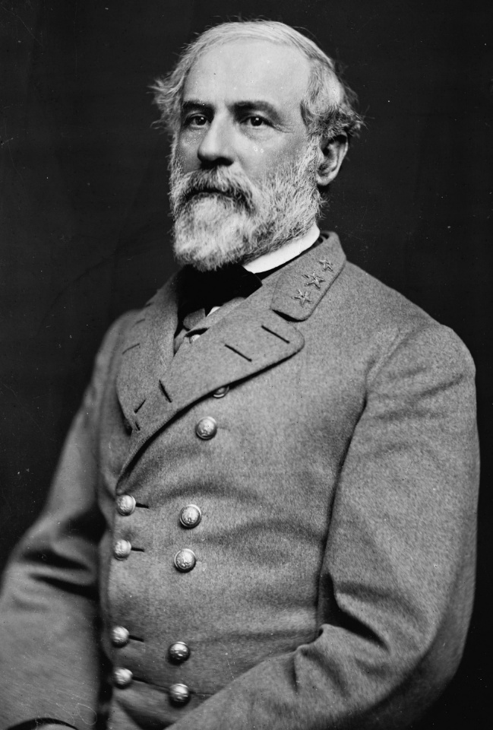
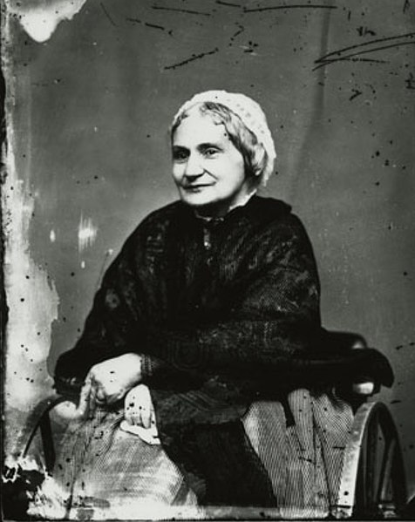
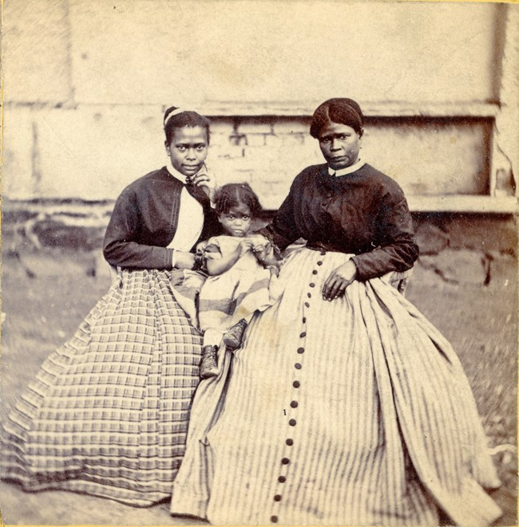
Who lived on this land before the Civil War?
Robert E. Lee
Mary Randolph Custis Lee
196 Enslaved People
Notes:
Slide Notes:
This slide provides some historical background and context about the history of the land that became Arlington National Cemetery.
Say & [Do]:
The property belonged to a woman named Mary Randolph Custis Lee, who had inherited the Arlington Plantation from her family. She was married to Robert E. Lee, who was a well-known Confederate general.
In addition to Mary and Robert and their children, there were 196 enslaved African Americans that lived on the Arlington plantation. This last photograph shows Selina Gray, who was the housekeeper at Arlington House, where they Lee’s lived, and her two daughters.
Now, if the Lees were to walk out the front door of their home (called Arlington House), let’s look at the view that they would see… [Move to next slide]

Slide 7
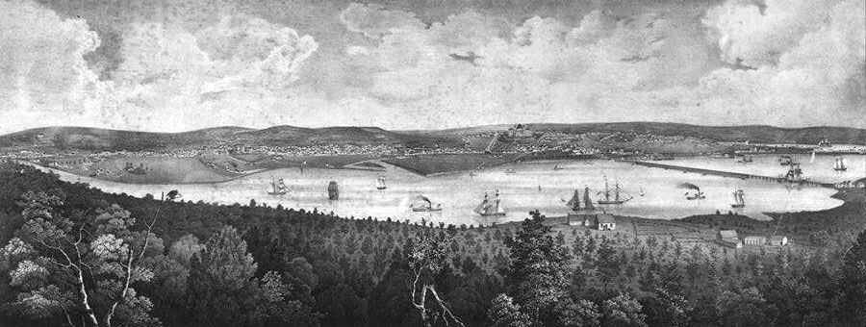
“View of the City of Washington” from Arlington House in 1838. (Library of Congress/Peder Anderson)
Notes:
Slide Notes:
This slide shows the view from Arlington House’s front lawn in the 1830s, shortly before the Civil War.
Say & [Do]:
This drawing shows us what the view looked like in 1838 (we can learn that from the caption of the drawing – which is important to always look at), which was 23 years before the start of the Civil War.
This view is really important! If we were sitting on the front porch of Arlington House at that time, we would see the Potomac River, which separated Virginia from Washington, D.C. And directly across the river, you see the capital city of Washington D.C. This means that Arlington House had the high ground and excellent views of the capital.
Let’s go look at this view at ANC today. [Move to next slide]

Slide 8


Let’s Go Visit Arlington National Cemetery!
Notes:
Slide Notes:
This slide provides a direct link to Google Maps and shows a modern-day view of the front lawn of Arlington House.
Say & [Do]:
[While navigating Google Maps, you can use the following script to guide you]
You are now standing on the hill in front of Arlington House. If we turn around [use the mouse to turn around and show Arlington House], you can see the home, which looks pretty grand with its big columns and large porch. Today, Arlington House is run by the National Park Service and Arlington National Cemetery surrounds the house [Continue to rotate back to view the city and point out that all the headstones are part of Arlington National Cemetery].
As you look around, you can see headstones all around. Arlington National Cemetery is owned and run by the U.S. Army.
Let’s turn back around to look out at that same view we saw a few moments ago. What do you notice? [Give learners a short amount of time to respond – many will notice the Washington Monument, maybe other monuments or buildings, etc.]
Some things that you can see now:
Washington, D.C., the nation’s capital (with the same river), but now lots more buildings, right? If we look closely, we can see the Washington Monument [use mouse to point out where the monument is in the center], at the end of the street here [use the mouse to point to the end of the main road out of Arlington and into the city] would be the Lincoln Memorial, the Jefferson Memorial is over here [to the right of the Washington Monument], along with the Capitol building, and the White House would be just over here [to the left of the Washington Monument]. You can also see lots of other buildings – these are the federal buildings where our government is working every day. From this spot, we are exactly 3 miles from the White House.
Also important is that you can see nearly the entire city from this spot, especially in the wintertime, when there is not a lot of tree cover.
The same was true in 1861 when the Civil War broke out, which made this spot a very strategic location. The fact that you can see Washington, D.C. is very important to why this became a national cemetery.
Washington D.C. is the capital of the United States. Arlington Plantation was part of Virginia. When the Civil War broke out, was Virginia part of the United States? [Give students an opportunity to answer and explain]
NO – the state of Virginia seceded from the U.S. at the beginning of the war, so this plantation was in the Confederacy. If the Confederate Army gained control of the property, they could fire on the city’s defenses and the capital city itself.
Everyone knew how important this land was. The U.S. Army knew that it provided protection to the city if it was in their control and the Confederacy knew that it was a strategic point with sightliness over the entire capital city.
So, let’s go look at a little timeline… [Move to the next slide]

Slide 9
Timeline: 1861
APRIL
MAY
17
20
15
23
Virginia government declares secession from the United States
Robert E. Lee resigns from the U.S. Army
Lee family flees Arlington House
Virginia voters confirm secession
U.S. Army occupies property
Notes:
Slide Notes:
This slide shows a timeline of the important events of the Spring of 1861, when Arlington Plantation was occupied by the U.S. Army.
Say & [Do]:
So now, let’s take a second to look at a timeline of some important events from 1861:
On April 17, the government of Virginia declared that they were leaving the United States by seceding
Three days later, on April 20, Robert E. Lee, who lived at Arlington House, resigned from the U.S. Army and joined the Confederate Army (in which he later became a general)
A little less than a month after that, on May 15, Mary Randolph Custis Lee and her children fled Arlington House to go south and join their husband and father in Richmond, VA
On May 23, the voters in Virginia confirmed the government’s decision to secede from the Union, and on that same evening, the U.S. Army moved in and took possession of the property so that they would have that strategic location overlooking the city’s defenses. From then on, this property has been occupied and run by the U.S. Army. [Move to next slide]

Slide 10
How did the U.S. Army use the property?
Make a guess!
Notes:
Slide Notes:
This slide provides an opportunity for students to pause and reflect and have a short discussion.
Say & [Do]:
At this point, the U.S. Army (which we sometime see called the Union Army) has possession of the Arlington Plantation and House. How do you think they used the property? Make a guess! [Give students an opportunity to respond either virtually or in-person and have a short discussion. Acknowledge their responses and then continue.]
Ok, you guys have some good thoughts here! Yes, the U.S. Army stationed some troops here, but really this gave them the high ground to create a fort that could be used to defend Washington, D.C. Let’s take a look… [Move to the next slide]

Slide 11
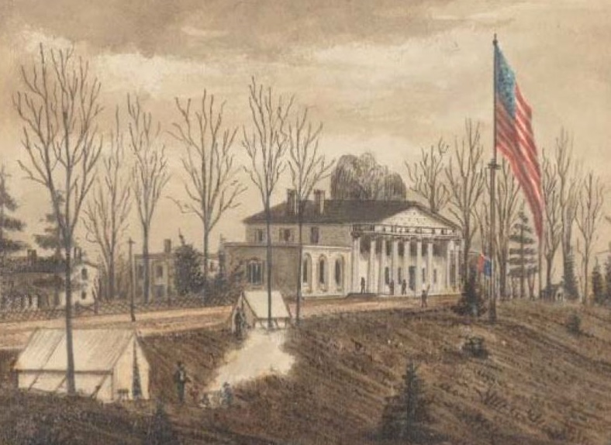
Notes:
Slide Notes:
This slide shows a drawing of Arlington House being occupied during the Civil War.
Say & [Do]:
By the end of the Civil War, Washington, D.C. was the most fortified city in the nation, and Arlington Plantation became one of 68 forts that surrounded the city. By that point, there were over 800 cannons being used to protect the city across those 68 forts, including at Arlington.
This drawing shows lots of different things that were happening at that time [Use mouse to point out the following areas]:
You can see some tents where soldiers are setting up camp
Some soldiers are manning the fires, maybe to keep warm since it looks like its wintertime (no tree cover), or maybe they’re cooking a meal
There are men standing guard in front of Arlington House and around the property
We see Arlington House there in the background, which was used to house officers at that time
In the military, you have different ranks. You have the enlisted soldiers who went out and actually fought the battles and follow the directions they are given. You also have officers, who were in charge – they were the ones making decisions, planning strategy, and giving the orders – and those men were housed at Arlington House [Move to the next slide]

Slide 12
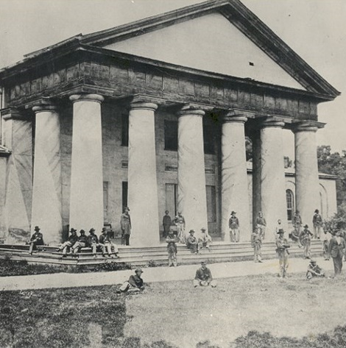
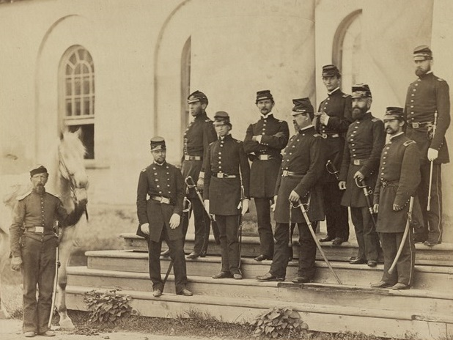
Notes:
Slide Notes:
This slide provides additional photographs of Arlington House during the Civil War.
Say & [Do]:
Here, you can see some photographs of what Arlington House looked like at that time. The image on the left shows men hanging out on the front porch and some of the officers that were housed there. In the image on the right, you can see some of the officers posing for a photo, one has a horse, and they are all in military uniform.
So, we know Arlington became a fort – but how did it become a cemetery?
Ok, so the Army comes in in 1861, and the Civil War keeps going. Some of you may have heard before that this was the deadliest war in American history, and that’s true – people were dying not only from casualties and injuries from battle, but also disease, and there were lots of battles in the Washington, D.C. area, meaning that there were also a lot of military hospitals. People were dying, and not everyone had the money to bring those who died to the place where they lived and bury them there, so they were often buried them near where they died. Eventually, the other cemeteries in the area were filling up and the Army realized that there was a lot of land surrounding Arlington house that could be used, so they decided to start burying service members who died in battle or from disease here in 1864. [Move to the next slide]

Slide 13
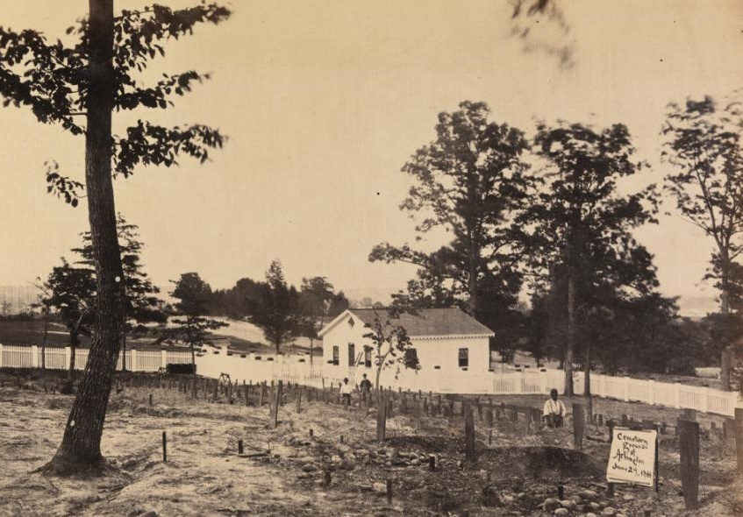
Notes:
Slide Notes:
This slide shows Section 27, the oldest section of the cemetery where the first burials took place.
Say & [Do]:
This is a photo of some of the first burials at Arlington in June 1864. Take a minute to look at this photograph. Do you see Arlington House in this photograph? (No!) Does it look the same as what we saw in the beginning? (No!) What looks different here? [Give learners an opportunity to respond to the differences in what they see here – perhaps that the headstones are wooden slabs, there’s not rows like we saw in the beginning, or the dirt and rocks instead of pristine lawns]
Some things you might have noticed:
Instead of gravestones, we see wooden boards to mark graves.
Instead of a pristine green lawn, we see dirt and rocks here.
Instead of rows of graves, we see lots of empty space and farmland back in the back (not covered in headstones yet).
The first person to be buried in this section, called Section 27, was William Henry Christman, a private from Pennsylvania, who died from disease in a nearby military hospital. From his burial, Arlington continued to bury others.
Ok, so let’s look at a map to try to figure out where this is on the Arlington property. [Move to the next slide]

Slide 14


1901
Map
Washington, D.C. and Potomac River
Notes:
Slide Notes:
This slide shows a map from 1901 showing different areas of the cemetery. There are animations on the slide that will animate different pieces in when you click your mouse.
Say & [Do]:
Maps are a great resource that help us learn about the past. They are primary sources from different times in history that can give us lots of valuable information. This is a map of Arlington National Cemetery from the year 1901, about 40 years after the Civil War. A lot of what you see here is not what it looked like during the Civil War, but some of it is the same.
Let’s take a minute to get ourselves situated with what we are looking at here. (CLICK – red circle animates in)
This circle is where Arlington House is located. (CLICK – arrow and label at the bottom of the map animates in)
Washington D.C. and the Potomac River (that view that we saw a bit ago) are located down here. When we were standing on the hill by Arlington house, we were facing toward DC and the river. (CLICK – Section 27 animates in)
And that area where the first burials took place is WAY OVER HERE [can use mouse to emphasize how far from Arlington House this section is] in what we now call Section 27.
We are often asked, “Why isn’t it called Section 1, since it’s where the first burials took place?” And the answer is, we don’t know! It’s a mystery to us that history can’t explain. You can see that they placed that section far away from Arlington House.
Now, let’s go explore some of the different headstones you can find when we walk through Section 27, and we can start to learn WHO is buried at Arlington National Cemetery. [Move to the next slide]

Slide 15
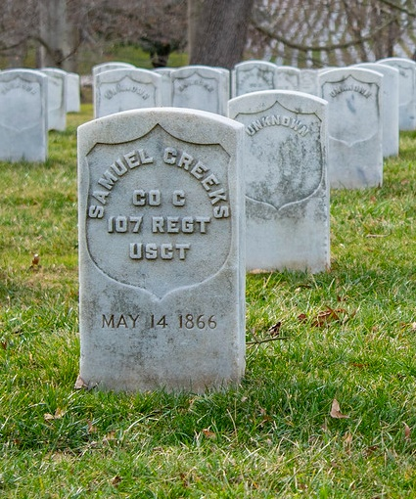
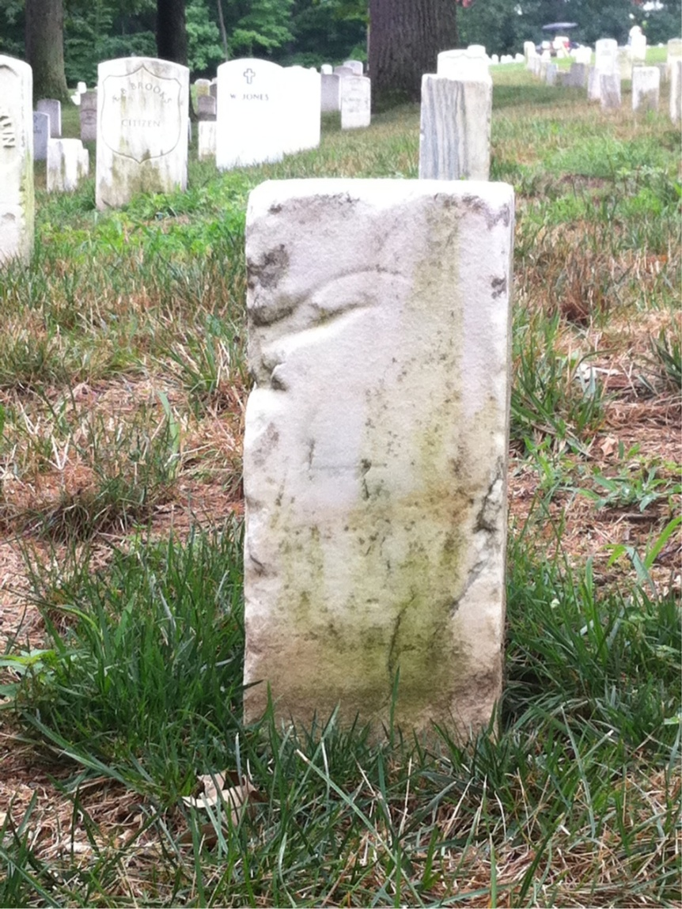
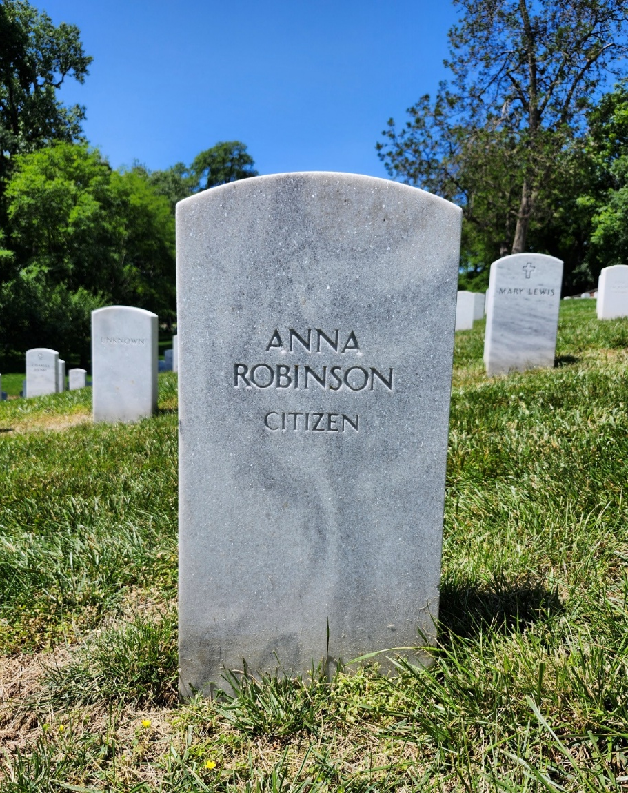
Notes:
Slide Notes:
This slide contains three images of gravestones from Section 27, each representing a different person buried there.
Say & [Do]:
When you are in Section 27, you can find a few different types of headstones.
You are seeing three different gravestones here from Section 27. What are some of the things that you see that are the same between these and what’s different? [Give learners time to respond virtually or in person, commenting on the similarities and differences between the headstones pictured]
Some things to pay attention to:
Is the stone color the same or different? Same
Is the shape the same or different? Two same, one different
Are the words the same or different? Different
How so?
What can you learn from the words on each?
Good, you guys noticed a few good things here! All three of these headstones are from people who died at some point around the Civil War era. Let’s start with this last gravestone that we see here. You might notice that this one is shaped a little differently and has no inscription or writing on it. Anyone want to take a guess as to why? [Take responses from learners]
Alright, we have some interesting guesses here. The reason this one looks different and has no writing is because we don’t know who was buried here. This is what we call an unknown or unidentified soldier. We don’t know his name, where he was from, or what his life looked like. This was before “dog tags” were used to identify military personnel. Those didn’t really come into play until World War I. After this soldier lost his life, the Army needed to bury him, so they have this grave marker, which allows us to still honor and remember his service, even though we aren’t sure who he was. This is one type of marker from the Civil War for unknown dead, some look like this, and others actually say “unknown.” So, in the case of this soldier, he not only lost his life, but he also lost his identity by serving.
Now let’s look at Samuel Creeks, the first image. Remember, gravestones are a primary source and we can learn some information from this marker. We can see that he served in Company C, of the 107th Regiment of the U.S.C.T. The U.S.C.T. stands for the United States Colored Troops, which was a segregated unit in the Army created during the Civil War. At that time, the military was segregated, so white troops served in certain regiments and African Americans served in others, so we know from this that he was a Black service member that served in one of those segregated regiments. We can also see that he died in 1866.
The middle gravestone is a little different and some of you noticed this when we looked at them earlier. This one is labeled “Citizen” which makes me really curious to know more about this person. What does this mean? How could I learn more about these people? [Allow learners to respond to ways we could learn more about each person – maybe we do an internet search, look at records, find other primary sources, etc.]
One way we can learn more about these people is to use primary sources and research their lives. Now, we knew that we wouldn’t have time to go and find this information together during our field trip today, so we’ve already done this research and explored the National Archives for more information. Using records like census records, death records, birth records, service records, and so on, we can learn a little more about Samuel Creeks and Anna Robinson. Let’s take a look at what we learned. [Move to the next slide]

Slide 16
Name: Samuel Creeks
Nickname: Creeks
Place of Birth: Kentucky
Year of Birth: 1843
Occupation: Laborer
Complexion: Black
Height: 5 feet, 11.25 inches
Place of Death: Washington, D.C.
Cause of Death: Tuberculosis
Formerly enslaved by a man named John Crockett
Notes:
Slide Notes:
This slide contains the information about Samuel Creeks from research done by the ANC Education team.
Say & [Do]:
From researching Samuel Creeks, we were able to learn that he was born in 1843 in Kentucky and was a laborer, meaning he did all kinds of odd jobs, probably manual work – so we can infer that he was probably pretty strong.
We know he was Black, since he served in the USCT, and had been enslaved by a man named John Crockett. We don’t know when he was a slave, or when he gained his freedom, but it is likely he gained his freedom through his service to the U.S. Army.
He was just shy of 6 feet tall and he died in 1866 in Washington, D.C. of tuberculosis, which was a serious lung disease that caused a lot of deaths around the time of the Civil War, before we had antibiotics to fight it.
There’s a lot we don’t know about Samuel Creeks - we don’t have any photographs of him, nor do we know anything about his family, friends, or how he liked to spend his time, because the records that exist don’t give us that information.
Research Link: https://kyusct.org/samuel-creeks-soldier-details-and-documents/
[**Might jump to previous screen to ask for observations on Anna Robinson before moving forward to her information**]

Slide 17
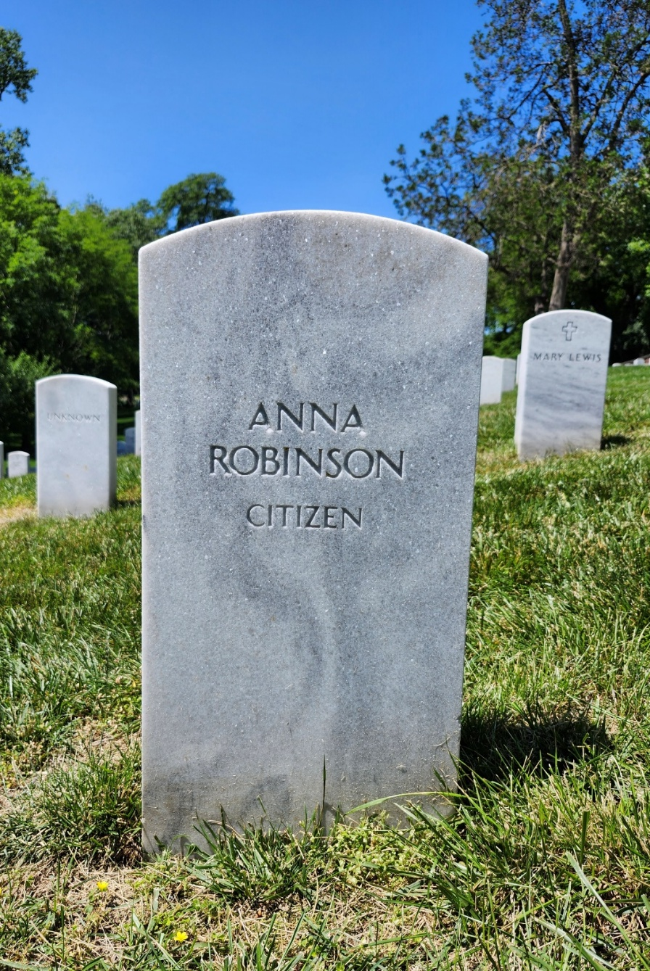
Name: Anna Robinson
Death Date: August 18, 1867
Age at Death: 15
Cause of Death: Consumption
Location of Death: Freedman’s Hospital, Washington, D.C.
Notes:
Slide Notes:
This slide contains the information about Anna Robinson from research done by the ANC Education team.
Say & [Do]:
How about Anna Robinson? There’s not a lot of information about her, but we were able to find a few additional details by examining her burial record from Arlington National Cemetery.
We don’t have a specific date that she was born, but we know she died young of consumption, which is another word for tuberculosis, that lung disease we heard about a moment ago in 1867.
We also learned that she died at the Freedman’s Hospital in Washington, D.C., which was significant because this was part of something called the Freedman’s Bureau. The Freedman’s Bureau was created by the government to help people who had been enslaved transition to freedom and citizenship. During and after the Civil War, African Americans gained their freedom from slavery and the term we use for this is Freedmen (newly freed men and women). They created schools, hospitals, and other organizations to support these newly freed African American men and women create a life for themselves. If you died at that time and didn’t have the money for a burial, the Freedman’s Bureau would bury you at Arlington National Cemetery.
Arlington National Cemetery has about 3,000 of these freedpeople buried here, and they all have the term “citizen” or “civilian” on their headstones
Eventually Section 27, where these gravestones are from, became a place where the U.S. Army buried African Americans. They buried white soldiers closer to Arlington House. Let’s go back to our map to learn a little more. [Move on to next slide]
-Citizen of the United States (not a service member)

Slide 18
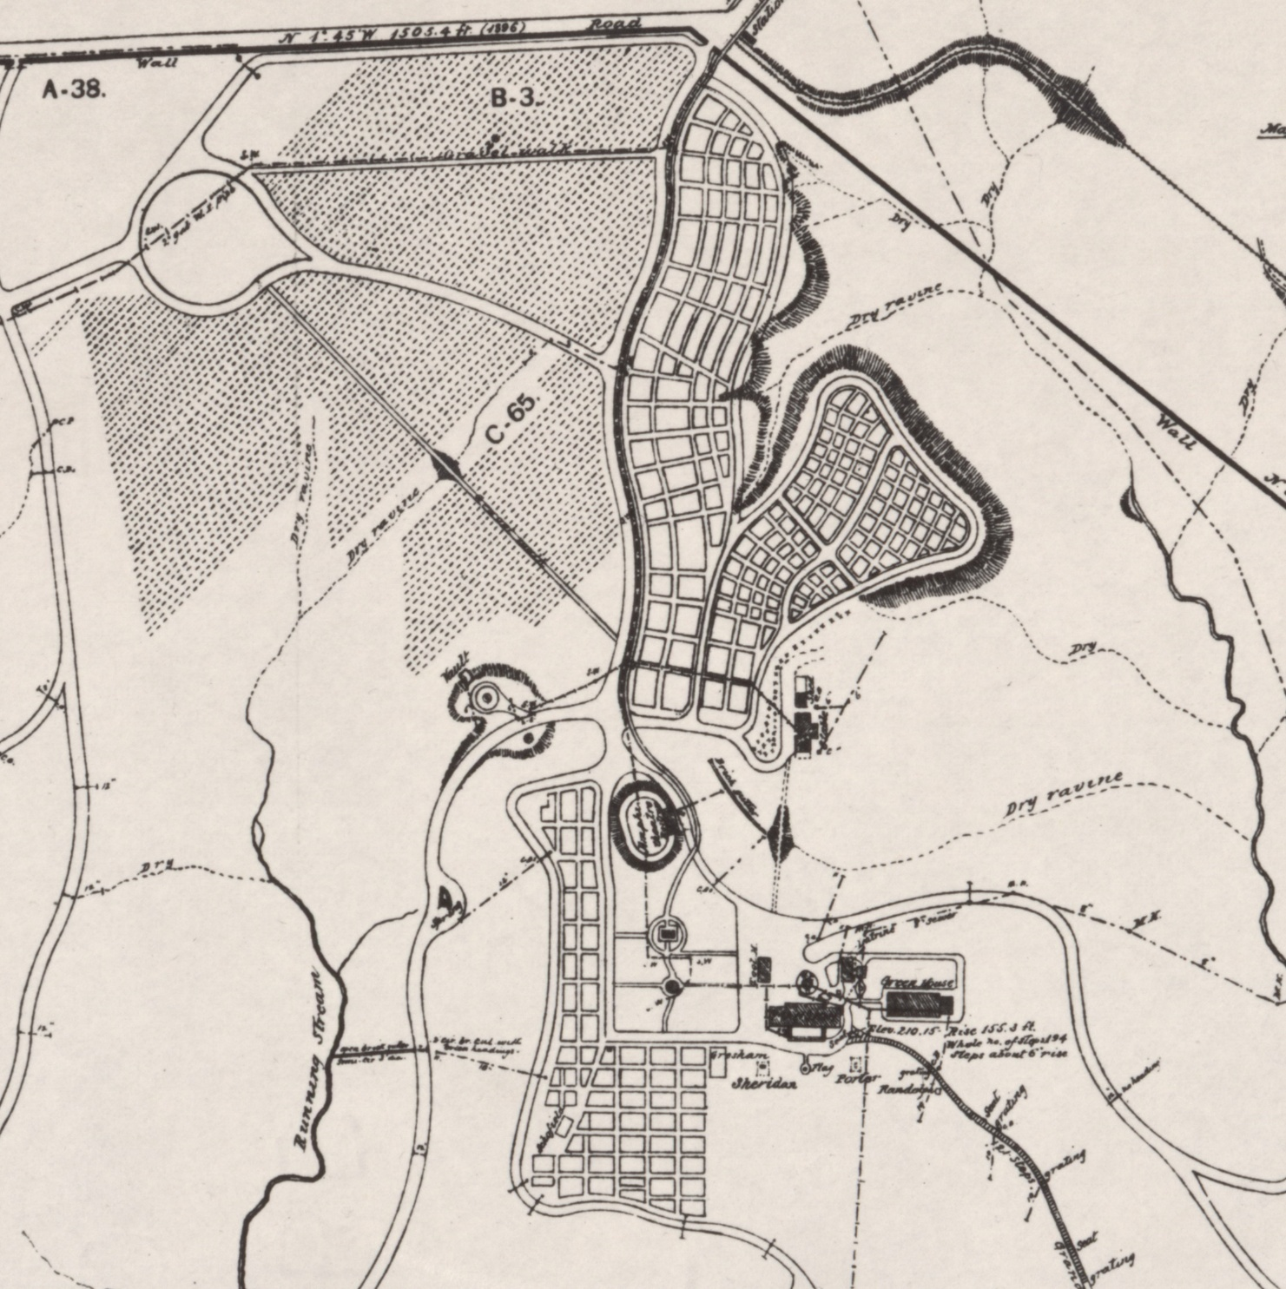
1901
Map
Section 27
Washington, D.C. and Potomac River
Notes:
Slide Notes:
This slide provides the same map from slide #14, this time showing other areas where people were buried. This map contains different animations that show the different areas in the script below.
Say & [Do]:
We’re back to our map from 1901. Once again, Arlington House is circled in red. In 1864, when they started burying people, they buried everyone in Section 27 – white, black, officers, and enlisted.
Shortly after those first burials took place in Section 27 where we just visited, Arlington became a national cemetery, and it became segregated, because the U.S. Army was segregated at that time. So now, white soldiers were being buried over closer to Arlington House and black soldiers continued to be buried in Section 27.
The U.S. Army at that time started burying white soldiers in two different sections: here (CLICK – animate in yellow section) and here (CLICK – animate in blue section)
Before we go explore these sections on the ground, do you notice anything different about what you are seeing in the yellow section versus the blue section? [Give learners an opportunity to answer the question and discuss the differences in the image]
[If needed, prompt learners]: Do you notice the difference in size of the dots?
The blue area has much larger spots that the yellow ones. Let’s take a look at this section of the cemetery in more detail to see why that is. [Move to next slide]

Slide 19

Let’s Go Visit Arlington National Cemetery!
Notes:
Slide Notes:
This slide provides the link to another Google Maps location within Arlington National Cemetery. When you click into this link, the first thing you’ll want to do is move forward down Meigs Dr. [Click forward 2-3 times for best results]. While you navigate Google Maps, you can use the script below.
Say & [Do]:
This is the blue area of the map [Use mouse to turn and look at the larger gravestones on the right of the screen] and this is the yellow area [use mouse to move now to the left side, showing the uniform headstones in rows].
What do you notice about these two sections? What sticks out to you? [Give learners time to respond and discuss]
Some possible things you might notice: the size of the headstones; the different shapes and styles of the headstones
Right! These headstones [show right side] are much larger and have lots of different styles while these [navigate to the left side] are all identical and in neat, orderly rows. Can you make any inferences or guesses as to why these two sections look so different? [Provide learners with time to discuss and respond]
There is a reason why these two sections look so different:
The bigger plots with these different styled headstones were for officers and the smaller ones are for enlisted soldiers. We talked about the difference earlier – enlisted are those that are fighting and on the ground in a battle. Officers are the leaders.
At Arlington, the government provides the headstones for military families as a way to honor and remember their service. These [show uniform markers on left side of screen] are the government–issued, free headstones. In the beginning, the cemetery said that if you wanted to pay more and have a different headstone, you could. Many officers’ families had the money to be able to do this, and they wanted to honor them with a larger, or more ornate headstone, and so they purchased these. Today, Arlington does not allow anyone to pay for a different headstone. Everyone is required to used the government provided headstone.
Today, you saw just a few small sections of the cemetery in our tour, but it is much larger. There are over 420,000 people buried here and since it is an active cemetery, there are still funerals every day except for Sundays. [Move to the next slide]
Google Maps Link: https://maps.app.goo.gl/QyNq4f8sz8iNnjRV9

Slide 20
Our Guiding Questions
What is Arlington National Cemetery?
Why does the cemetery exist?
Who is buried here?
To keep in mind:
Why does the cemetery matter?
Who do we honor and remember?
Notes:
Slide Notes:
This slide provides the same guiding questions from the beginning of the presentation. Use these to circle back and review what was learned and provide learners with additional time to process information.
Say & [Do]:
As we wind down our time together, let’s take a minute to review our questions from the beginning of our session!
We wanted you all to have a better idea of what Arlington National Cemetery is and why it exists as well as who is buried here. You now know that it is a national cemetery, created during the Civil War, for military service members and their families and allows us to honor and remember the service of those people who have sacrificed to serve the United States.
We also had our questions you were supposed to keep in mind. Even after we leave here today, I want you to really think about WHO we honor and remember, WHY we honor and remember them, and HOW we honor and remember them.
[If time permits, ask students to share their thoughts on who, why and how we honor and remember military and their families]

Slide 21

Questions?
Notes:
Slide Notes:
This slide provides an opportunity to open it up for questions from learners.
Say & [Do]:
Do you have any additional questions?

Slide 22
Exit Ticket
  One thing I learned on this virtual field trip that surprised me…
Notes:
Say & [Do]:
To complete our virtual field trip, answer the prompt on screen: “One thing I learned that surprised me…”

